Slide 1
Vector processors:
Vector Processors
Department of Electrical Engineering Stanford University
Christos Kozyrakis

Slide 2
Announcements
Readings for this lecture
H&P 4th edition, Appendix F
Required paper
HW3 available on online
Due on Wed 11/11th
Exam on Fri 11/13, 9am - noon, room 200-305
All lectures + required papers
Closed books, 1 page of notes, calculator
Review session on Friday 11/6, 2-3pm, Gates Hall Room 498

Slide 3
Review: Multi-core Processors
Use Moore’s law to place more cores per chip
2x cores/chip with each CMOS generation
Roughly same clock frequency
Known as multi-core chips or chip-multiprocessors (CMP)
Shared-memory multi-core
All cores access a unified physical address space
Implicit communication through loads and stores
Caches and OOO cores lead to coherence and consistency issues

Slide 4
Review: Memory Consistency Problem
P₁
P₂
/*Assume initial value of A and flag is 0*/
A = 1;
flag = 1;
while (flag == 0); /*spin idly*/
print A;
Intuitively, you expect to print A=1
But can you think of a case where you will print A=0?
Even if cache coherence is available
Coherence talks about accesses to a single location
Consistency is about ordering for accesses to difference locations
Alternatively
Coherence determines what value is returned by a read
Consistency determines when a write value becomes visible

Slide 5
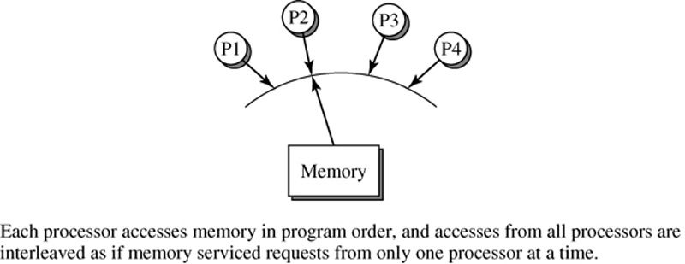
Sequential Consistency
(What the Programmers Often Assume)
Definition by L. Lamport:
– A system is sequentially consistent if the result of any execution is the same as if (a) the operations of all processors were executed in some sequential order, and (b) the operation of each individual processors appear in the order specified by the program.
What does SC mean for an OOO processor with caches?
–
Any extra requirements on top of data flow dependencies?

Slide 6
Alternative 1: Relaxed Consistency Models
Relax some of the SC ordering requirements
In hope of higher performance from hardware
But must be careful about programming implications
Example: processor consistency (Intel) or total store order (Sun)
A read can commit before an earlier write from the same core (with different address) or from another core (to any address) is visible
Allows for FIFO store buffers
Loads can bypass a buffered store to a different address
Example: relaxed consistency (IBM)
Relax all read/write orderings
SW inserts memory barriers (fences) to enforce order when truly needed
Can be tricky
Vector processors - 6

Slide 7
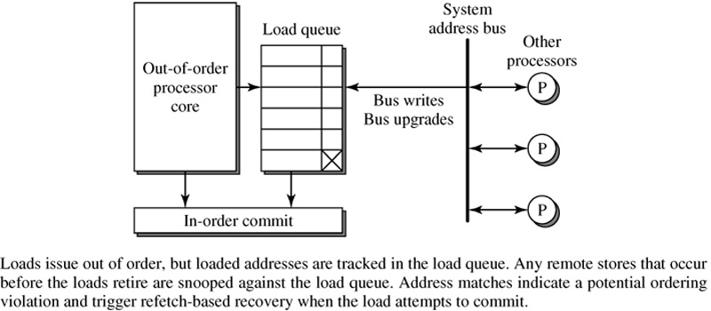
Alternative 2: Use HW Speculation Mechanisms
Reorder loads and store aggressively but track for SC violations
Check point: when load or store is committed from the ROB
Executing loads early
Must ensure that when load commits the value read is still valid
Keep a table with speculatively read values and flag a violation if a write to same value is written by other threads
Reordering stores early
Acquire exclusive access to cache line asap
Check if in exclusive state again when at the head of the ROB

Slide 8
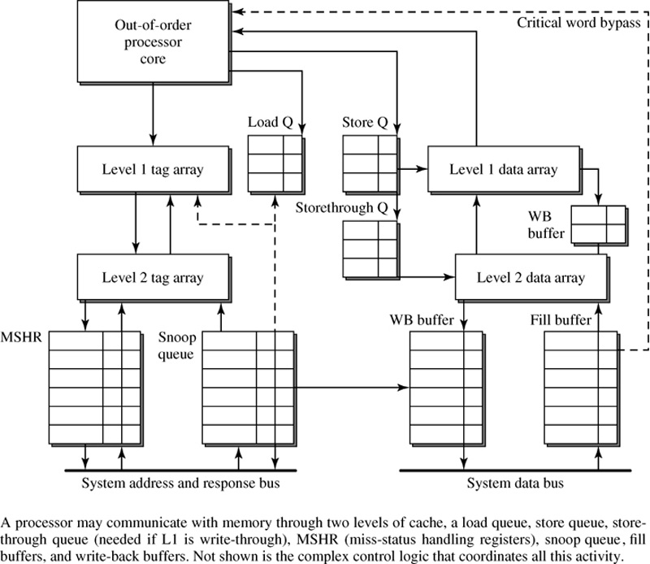
Put It All Together: The CPU-Memory Interface

Slide 9
Synchronization and Mutual Exclusion
Motivation
How to ensure that :22 concurrent processes cannot simultaneously access the same data or execute same code
Needed for parallel programs or programs that share data and OS services
E.g. two editor processes updating the same file
Can we use regular load/store instructions to do mutual exclusion?
L1: load flag;
If (flag == 0) store flag=1; else goto L1;
Work(); /* need exclusive access */ store flag=0;
Does this work correctly on single-core or multi-core?
Assume cache coherence and sequential consistency

Slide 10
HW Support for Mutual Exclusion & Synchronization
Atomic instructions: many flavors, same goal – Atomic exchange
Atomically exchange values in register – memory location
Atomic test & set instruction
Test if value is 0 and set to 1 if test is successful
Atomic compare & swap instruction
Test if value is 0 and set it to other value if test is successful
Atomic fetch and increment
Read old value and store +1
Load-linked and store-conditional instructions
LL: Load & remember old value
SC: Store if old value still in memory
Implementation: need support from CPU, caches, and memory controller
Can be used to implement higher level synchronization constructs
– Locks, barriers, semaphores, … (see CS140 & CS315A)

Slide 11
Our Simple Example Revisited
New version assuming atomic exchange
– Initial value of Reg=1 and flag=0
L1: atom_exchange Reg, flag; If (Reg == 1) goto L1;
Work(); /* exclusive access */ Reg = 1;
store flag = 0;
Does this work correctly on uniprocessors or multi-processors?

Slide 12
Example: Implementation of Spin Locks
Spin lock: try to find lock variable 0 before proceeding further
With atomic exchange
try: | li R2,#1
lockit: | lw R3,0(R1) | #load var
 | bnez R3,lockit | #not free=>spin
 | exch R2,0(R1) | #atomic exchange
 | bnez R2,try | #already locked?
With Load-linked & Store-conditional
lockit: | ll R2,0(R1) | #load linked
 | bnez R2,lockit | #not free=>spin
 | li R2,#1 | #locked value
 | sc R2,0(R1) | #store
 | beqz R2,lockit | #branch if store fails

Slide 13
Vector Processors

Slide 14








Vector Processors
SCALAR
(1 operation)
+
add r3, r1, r2
VECTOR
(N operations)
v1 v2
+
v3
r1
r2
r3
vector length
vadd.vv v3, v1, v2
Scalar processors operate on single numbers (scalars)
Vector processors operate on vectors of numbers
– Linear sequences of numbers

Slide 15
What’s in a Vector Processor
A scalar processor (e.g. a MIPS processor)
Scalar register file (32 registers)
Scalar functional units (arithmetic, load/store, etc)
A vector register file (a 2D register array)
Each register is an array of elements
E.g. 32 registers with 32 64-bit elements per register
MVL = maximum vector length = max # of elements per register
A set for vector functional units
Integer, FP, load/store, etc
Some times vector and scalar units are combined (share ALUs)

Slide 16
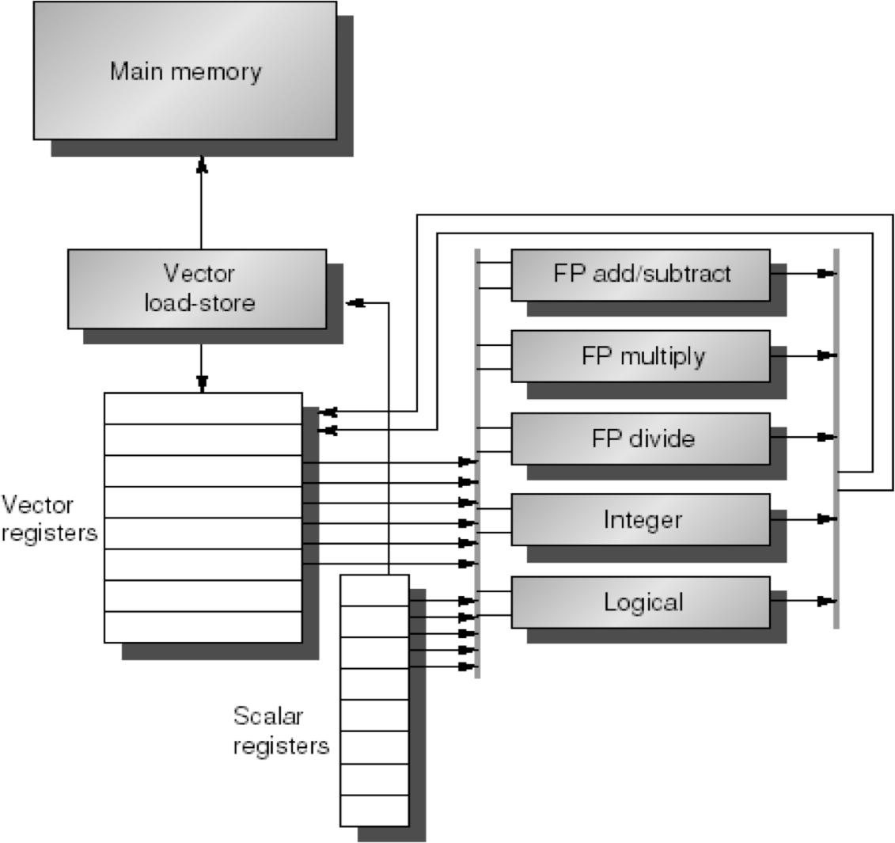
Example Vector Processor

Slide 17
Basic Vector Instructions
Instr. | Operands | Operation | Comment
VADD.VV | V1,V2,V3 | V1=V2+V3 | vector + vector
VADD.SV | V1,R0,V2 | V1=R0+V2 | scalar + vector
VMUL.VV | V1,V2,V3 | V1=V2*V3 | vector x vector
VMUL.SV | V1,R0,V2 | V1=R0*V2 | scalar x vector
VLD | V1,R1 | V1=M[R1...R1+63] | load, stride=1
VLDS | V1,R1,R2 | V1=M[R1…R1+63*R2] | load, stride=R2
VLDX | V1,R1,V2 | V1=M[R1+V2_{i},i=0..63] | indexed("gather")
VST | V1,R1 | M[R1...R1+63]=V1 | store, stride=1
VSTS | V1,R1,R2 | V1=M[R1...R1+63*R2] | store, stride=R2
VSTX | V1,R1,V2 | V1=M[R1+V2_{i},i=0..63] | indexed(“scatter")
+ all the regular scalar instructions (RISC style)…

Slide 18
Vector Code Example
Y[0:31] = Y[0:31] + a*X[0:31]
32 element SAXPY: scalar |  | 32 element SAXPY: vector
LD | F0, a | LD | F0,a | #load a
ADDI | R4, Rx,#256 | VLD | V1,Rx | #load X[0:31]
L: LD | F2, 0(Rx) | VMULD.SV | V2,F0,V1 | #vector mult
MUL.D LD ADD.D | F2, F0, F2 F4, 0(Ry) F4, F2, F4 | VLD VADDD.VV VST | V3,Ry V4,V2,V3 Ry,V4 | #load Y[0:31] #vector add #store Y[0:31]
SD | F4, 0(Ry)
ADDI | Rx, Rx, 8
ADDI | Ry, Ry, 8
SUB | R20,R4,Rx
BNZ R20,L

Slide 19
Vector Length
A vector register can hold a maximum number of elements
Maximum vector length or MVL
What to do when the application vector length is not exactly MVL?
Vector-length (VL) register controls the length of any vector operation, including a vector load or store
E.g. vadd.vv with VL=10 is
for (i=0; i<10; i++) V1[i]=V2[i]+V3[i]
VL can be anything from 0 to MVL
Set it before each instruction or group of instructions
How do you code an application where the vector length is not known until run-time?

Slide 20
Strip Mining
Suppose application vector length > MVL
Strip mining
Generation of a loop that handles MVL elements per iteration
A set operations on MVL elements is translated to a single vector instruction
Example: vector SAXPY of N elements
First loop handles (N mod MVL) elements, the rest handle MVL
VL = (N mod MVL);
for (i=0; i<VL; i++) Y[i]=a*X[i]+Y[i];
low = (N mod MVL); VL = MVL;
for (i=low; i<N; i++)
//set VL = N mod MVL
//1st loop is a single set of
// vector instructions
// set VL to MVL
// 2nd loop requires N/MVL
Y[i]=a*X[i]+Y[i]; // sets of vector instructions

Slide 21
Advantages of Vector ISAs
Compact: single instruction defines N operations – Also reduces the frequency of branches
Parallel: N operations are (data) parallel
No dependencies
No need for complex hardware to detect parallelism (similar to VLIW)
Can execute in parallel assuming N parallel datapaths
Expressive: memory operations describe patterns
Continuous or regular memory access pattern
Can prefetch or accelerate using wide/multi-banked memory
Can amortize high latency for 1st element over large sequential pattern

Slide 22
Vector Optimization 1: Chaining
Suppose the following code with VL=32:
vmul.vv vadd.vv
Chaining
V1,V2,V3 V4,V1,V5
# very long RAW hazard
V1 is not a single entity but a group of individual elements
Pipeline forwarding can work on an element basis
Flexible chaining: allow vector to chain to any other active vector operation => more read/write ports
Unchained
vmul
vadd
vmul
Chained
vadd

Slide 23
Vector Optimization 2: Multiple Datapaths per Functional Unit
vadd.vv V3,V2,V1 (VL=N)
V2[3]
V2[2]
V2[1]
V1[3]
V1[2]
V1[1]
V2[13] V1[13] V2[13] V1[13] V2[14] V1[14] V2[15] V1[15]
V2[9] V1[9]
V2[5] V1[5]
V2[9] V1[9] V2[10] V1[10] V2[11] V1[11]
V2[5] V1[5] V2[6] V1[6] V2[7] V1[7]
+
+
+
+
+
V3[1]
V3[0]
V3[1] V3[2]
4 elements/cycle N/4 cycles
4 adders
V3[3]
1 element/cycle N cycles
1 adder

Slide 24
Vector Optimization 2+: Multiple Lanes
Pipelined Datapath
Lane
Vector Reg.
Partition
Elements
Elements
Elements
Elements
Functional Unit
To/From Memory System
Elements for each vector register interleaved across the lanes
Each lane receives identical control
Multiple element operations executed per cycle
Modular, scalable design
No need for inter-lane communication for most vector instructions

Slide 25








Chaining & Multi-lane Example
Scalar
LSU
FU0
FU1
vld vmul.vv vadd.vv addu vld vmul.vv vadd.vv addu
VL=16, 4 lanes,
2 FUs, 1 LSU
chaining -> 12 ops/cycle
Just 1 new instruction issued per cycle
!!!!
Time
Element Operations:
Instr. Issue:

Slide 26
Vector Optimization 3: Conditional Execution
Suppose you want to vectorize this:
for (i=0; i<N; i++) if (A[i]!= B[i]) A[i] -= B[i];
Solution: vector conditional execution
Add vector flag registers with single-bit elements (masks)
Use a vector compare to set the a flag register
Use flag register as mask control for the vector sub
Add executed only for vector elements with corresponding flag element set
Vector code
vld | V1, | Ra
vld | V2, | Rb
vcmp.neq.vv | M0, | V1, V2 | # vector compare
vsub.vv | V3, | V2, V1, M0 | # conditional vadd
vst | V3, | Ra
Conditional execution & multiple lanes
– Can you skip masked element operations without intra-lane communication?

Slide 27
Making a Vector Processor Multimedia-ready
(From Supercomputing to Embedded in 3 Easy Steps)
Support narrow data types
Allow each vector registers to store 64, 32, or 16-bit elements
Use a control register to indicate the width of elements in registers
Support saturated and fixed-point arithmetic
Minor twist to functional units
Support element permutations for vectorized reductions
for (i=0; i<N; i++) S += A[i]
Rewrite as
for (i=0; i<N; i+=VL) S[0:VL-1] += A[i:i+VL-1];
for (i=0; i<VL; i++) S+=S[i];
First loop is trivially vectorizable
Can vectorize 2nd loop with a permutation instruction that splits the elements of a vector register into two registers
Continue the binary-tree approach to reductions

Slide 28
VIRAM Architecture State
General Purpose Vector Registers
vr₀ vr₁
Scalar Registers
r₀ r₁
^{r}15
64 bits
vr₃₁
vf₀ vf₁
Vector Flag Registers
vf₁₅
1 bit
Element width is 64b, 32b, or 16b
More elements per vector register for narrow data

Slide 29
Example: DSP Support in the VIRAM ISA
z
x
n
n/2
+
sat
w
*
n
n
Round
y
n
n/2
a
Support for fixed-point numbers, saturation, rounding modes
Multiply-add model for efficient compilation
Simple instructions for intra-register permutations for reductions and butterfly operations
– High performance for dot-products and FFT without the complexity of a random permutation
EE382A – Autumn 2009
Vector processors - 29
Christos Kozyrakis
29

Slide 30
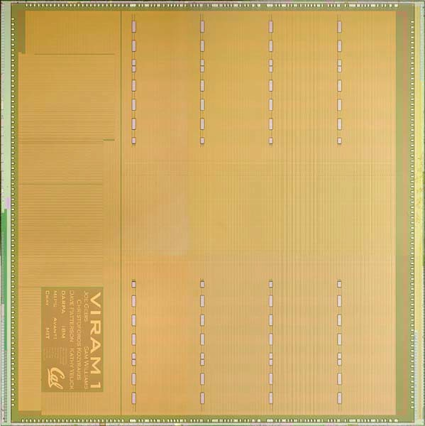
Putting it All: Vector IRAM Prototype Vectors + Embedded DRAM
VIRAM media processor
125M transistors
200MHz, 2 Watt
Embedded DRAM
 |  | DRAM | DRAM | DRAM | DRAM
MIPS CPU
I/O |  | crossbar
Vector Control |  | Lane 0 |  | Lane 1 |  | Lane 2 |  | Lane 3
13 Mbytes
8 banks
6.4GB/sec per bank (peak)
crossbar
DRAM | DRAM | DRAM | DRAM
Processor
4-lane vector processor
6.4 Gop/sec
64-bit MIPS core

Slide 31
Other Interesting Vector Instructions: Compress, Expand, PopCount, …
Compress
Pack all the non-masked elements of an input vector register into the first few elements of a destination vector register
Expand (reverse of compress)
Distribute the first few elements of the input register into the non-masked elements of the destination vector register
Compress & expand used for dense execution of conditional operations
PopCount
Count the number of non-masked elements in a vector
FindFirstOne, FineLastOne, …
Find # of first non-masked element, etc
SetBeforeFirstOne, SetIncludingFirstOne, …
Create a mask register with 1s up to the first 1 in the source register, etc
Insert, extract
Move single vector element to/from scalar register

Slide 32
Automatic Vectorization
// Matrix-matrix multiply: c[i][j]=SUM(a[i][t]*b[t][j]) for (i=1; i<n; i++) {
for (j=1; j<n; j++) { sum = 0;
for (t=1; t<n; t++) {
sum += a[i][t] * b[t][j]; // dependence
}
c[i][j] = sum;
}
}
Which loop to vectorize?
Inner loop and outer loop vectorization
See any tradeoffs?
Automatic vectorization requires extensive capabilities for dependence analysis

Slide 33
Which Applications Fit the Vector Model?
Vectors are great when we have data-level parallelism (DLP)
Most efficient way to exploit DLP
Remember, we can exploit DLP as ILP or TLP
On a superscalar or multiprocessor
Which applications have DLP?
Scientific computing
Weather forecast, car-crash simulation, biological modeling
Vector processors were invented for this purpose (supercomputers)
Multimedia computing
Speech, image, and video processing
Identical operations execution on streams or arrays of sound samples, pixels, and video frames
The reason for the recent revival of vector architectures
Multimedia on embedded devices
– Need high performance @ low power @ low complexity @ small code size

Slide 34
The Timeline of Vector Processors
Widely used for supercomputing systems in the 70s – 90s
Cray, CDC, Convex, TI, IBM, ..
Fell out of fashion in the 80s and 90s
Difficult to fit a vector processor in a single chip
Building supercomputers out of commodity microprocessors
Remaining vector supercomputer: NEC SX-9
8 lanes (5 functional unites), 8+64 vregs (256 elements/reg), 3.2GHz
But now vectors are making a come back
Short vectors in all ISAs (SIMD), Intel Larabee, …
Why?

Slide 35
Vector Power Consumption
Can trade-off parallelism for power
Power = C *Vdd2 *F
If we double the lanes, peak performance doubles
Halving F restores peak performance but also allows halving the Vdd
Powernew = (2C)*(Vdd/2)2*(f/2) = Power/4
Simpler logic for large number of operations/cycle
Replicated control for all lanes
No multiple issue or dynamic execution logic
Simpler to gate clocks
Each vector instruction explicitly describes all the resources it needs for a number of cycles
Conditional execution leads to further savings

Slide 36
SIMD Extensions for Superscalar Processors
Every CISC/RISC processor today has SIMD extensions
MMX, SSE, SSE-2, SSE-3 3D-Now, Altivec, VIS, …
Basic idea: accelerate multimedia processing
Define vectors of 16 and 32 bit elements in regular registers
Apply SIMD arithmetic on these vectors
Nice and cheap
Don’t need to define big vector register file
Takes up area and complicates exceptions
All we need to do
Add the proper opcodes for SIMD arithmetic
Modify datapaths to execute SIMD arithmetic
Certain operations are easier on short vectors
Reductions, random permutations

Slide 37
Example of Simple SIMD Instruction
SIMD ADD
64-bit reg. 64-bit reg.
+
+
+
+
64-bit reg.

Slide 38
Example of Fancy SIMD Instruction
Sum of Partial Products
64-bit reg. 64-bit reg.
*
*
*
*
temp. result
+
+
64-bit reg.

Slide 39
Loading & Storing SIMD Values
Typical case: no vector-like loads & stores
Must use regular 64-bit load/store instructions
Problems: data-sizes, alignment, strides
Solution: multiple load/stores & manipulation instructions
Pack & unpack
To solve problems with data sizes
Rotate & shift
To solve problem with alignment

Slide 40
Problems with SIMD Extension
SIMD defines short, fixed-sized, vectors
Cannot capture data parallelism wider than 64 bits
Must use wide-issue to utilize more than 64-bit datapaths
SSE and Altivec have switched to 128-bits because of this
SIMD does not support vector memory accesses
Strided and indexed accesses for narrow elements
Needs multi-instruction sequence to emulate
Pack, unpack, shift, rotate, merge, etc
Cancels most of performance and code density benefits of vectors
Compiler support for SIMD?
They change too often…

Slide 41
Superscalar+SIMD Vs. True Vectors: Example
 | Vector | MMX
iDCT | 0.75 | 3.75 (5.0x)
Color Conversion | 0.78 | 8.00 (10.2x)
Image Convolution | 1.23 | 5.49 (4.5x)
QCIF (176x144) | 7.1M | 33M (4.6x)
CIF (352x288) | 28M | 140M (5.0x)
QCIF and CIF numbers are in clock cycles per frame
All other numbers are in clock cycles per pixel
MMX results assume no first level cache misses

Slide 42
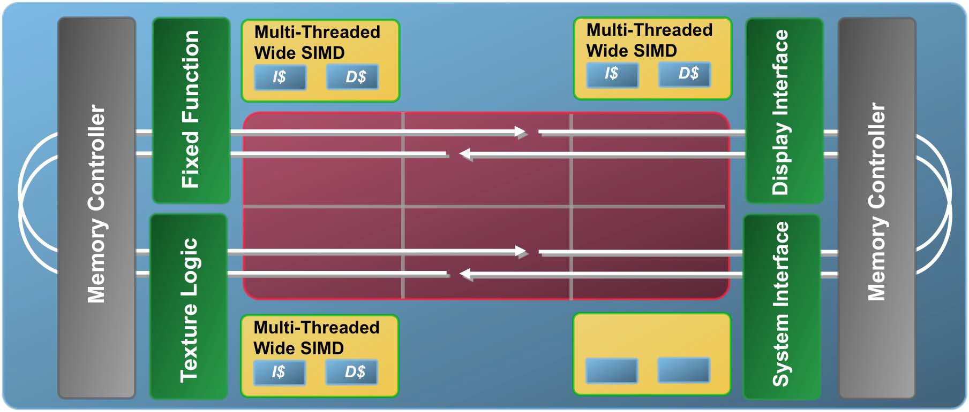











Intel Larrabee:
A Single-Chip Vector Multiprocessor
. . .
Multi-Threaded Multi-Threaded
Wide SIMD Wide SIMD
I$ D$ ^{I$ D$}
Multi-Threaded Wide SIMD
I$ D$
Multi- Multi-
Threaded Threaded
Wide SIMD Wide SIMD
Multi- Multi-
Threaded Threaded
Wide SIMD Wide SIMD
Memory Controller
Texture Logic Fixed Function
System Interface Display Interface
Memory Controller
Memory Controller
L2 Cache
. . .
Multi-Threaded Wide SIMD
I$ D$
2-way issue, in-order cores with vector capabilities
• + 4-way multithreaded
Cores communicate on a wide ring bus
L2 cache is partitioned among the cores
Provides high aggregate bandwidth
Allows data replication & sharing
Microarchitecture (Larrabee)

Slide 43




Larrabee x86 Core Block Diagram
Instruction Decode
Separate scalar and vector units with separate registers
In-order x86 scalar core
Vector unit: 16 32-bit ops/clock
Short execution pipelines
Fast access from L1 cache
Direct connection to each core’s subset of the L2 cache
Prefetch instructions load L1 and L2 caches
Scalar Unit
Vector Unit
Scalar Registers
Vector Registers
L1 Icache & Dcache
256K L2 Cache Local Subset
Ring
Microarchitecture (Larrabee)

Slide 44


Larabee Vector Unit Block Diagram
Vector complete instruction set
32 vector registers (512 bits), 8 mask registers
Scatter/gather for vector load/store
Mask registers select lanes to write, which allows data-parallel flow control
This enables mapping a separate execution kernel to each VPU lane
Vector instructions support
Fast read from L1 cache
Numeric type conversion and data replication while reading from memory
Rearrange the lanes on register read
Fused multiply add (three arguments)
Int32, Float32 and Float64 data
Mask Registers
16-wide Vector ALU
Replicate
Reorder
Vector Registers
Numeric Convert
Numeric Convert
L1 Data Cache

Slide 45
Summary
Vector processors
Processors that operate on linear sequences of numbers
Vector add, vector load, vector store, …
Can express and exploit data-level parallelism in applications
SIMD extension
Short vector extensions for ILP processors
Get some of the advantages of vector processors without most of the cost
Remember what Jim Smith said:
“The most efficient way to execute a vectorizable applications is a vector processor”

